Slide 1

Team Name : AmrithaVarshini
Team Details: Suryamritha M, Varshini Balaji

Slide 2

Proposed Solution-1 (FIND YOUR COLOR)
User Interaction Flow
Upload Image: Users select an image file to upload.
Image Analysis: The backend analyzes the image to extract dominant and suggested colors.
Display Results: Results include:
The uploaded image displayed back to the user.
A color palette showing the extracted dominant and suggested colors.
Recommended clothing items that match the color palette.

Slide 3
Key Features
Dynamic UI: The interface dynamically updates based on user actions and server responses.
Color Theory Integration: Utilizes color theory algorithms to suggest complementary colors.
Interactive Recommendations: Allows users to click on suggested colors and clothing items for more details.

Slide 4
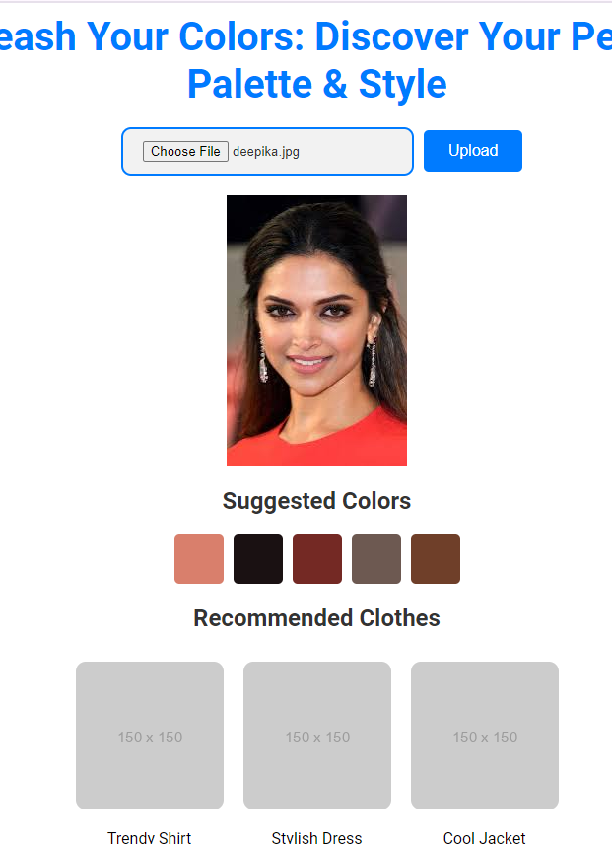
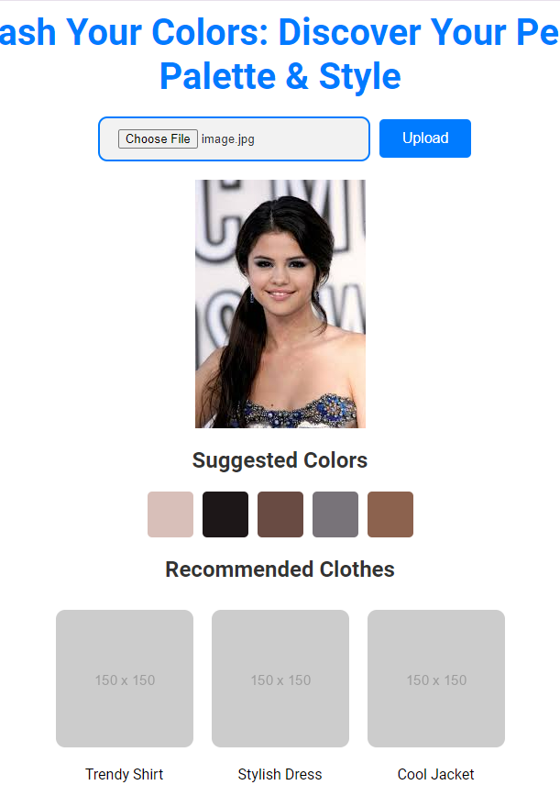
Website
The website allows users to upload images, analyzes them to extract dominant colors, and then suggests complementary colors and clothing items that match the uploaded image's color palette.

Slide 5
Proposed Solution-2 (OUTFIT VISUALIZER)
As a Gen Z shopper, a significant challenge faced during online shopping is the inability to visualize how different clothing items match. This can lead to uncertainty about color coordination and style compatibility.
Outfit Visualizer has the following features:
Image Upload: Users can directly upload images of clothing items from shopping websites into the Outfit Visualizer.
Arrange and Style: Users can arrange, reorder, and resize items on a virtual canvas to see how well they coordinate together.
Save Outfits: Users have the option to save their outfit combinations for future reference.
Share with Friends: The platform allows users to share their saved outfits with friends to gather feedback and opinions on style choices.
Direct Add to Cart: Users can add items they like directly to their shopping cart from the Outfit Visualizer.

Slide 6
Benefits
Reduce Returns: By visualizing outfits before purchasing, users can make more informed decisions, thereby reducing the likelihood of returns due to dissatisfaction.
Enhanced Shopping Experience: Users can confidently select items that match their personal style.
Social Interaction: Sharing outfits fosters social interaction and enhances decision-making.
Increased Customer Satisfaction: By visualizing outfits, customers are more likely to be satisfied with their purchases, reducing return rates.
This approach not only streamlines the shopping experience but also empowers users to make better choices regarding their wardrobe.

Slide 7
